Slide 1
Living Well with Dementia
Session 8 –
Staying active
Facilitated by:
Judith Davidson (Occupational Therapist)
Jessica Rhodes (Assistant Psychologist)

Slide 2
Ice Breaker
Welcome back!
How has your week been?
Have you started working towards your goal?
Notes:
Prompting Questions:
What steps have you made towards your goal?
How did this go and how did you feel?
What were the positive and the less positive effects of the change you made?
If you did not make progress on your goal, what stopped you from doing it?

Slide 3
Last Week
What did we discuss?
What can I do well?
Making a change
Taking charge of your life
Driving

Slide 4
This Week
Staying Active
Physical activity
Mental activity
Social activity
Session review and goodbye!
Notes:
Today we will talk about how we can stay active and continue living actively. We will talk about what you remember the most from the session, but also what else you would like to know. We have gone a long way and worked hard to get here and learn about dementia and living with it. So we all deserve a small celebration.
Last week we talked about how we can live well. Let’s now discuss what exactly we can do to stay active. What can you do to feel good physically and mentally?
To feel good, you need to focus on both, physical and mental wellbeing. This involves physical activity, mental activity, social activity and also good diet.

Slide 5
Physical Activity
Exercise helps people stay well for longer and can help prevent depression.
What could you do to stay physically active?
Notes:
Evidence shows that exercise helps people stay well for longer. Being physically active also helps to prevent depression and helps you feel well.
What could you do to stay physically active? You could take a short walk for 20 minutes every day, for example walk a dog if you have one. You could also go out play with grandchildren or exercise your upper body when sitting down.
If you smoke, then try to cut this down.

Slide 6
Mental Activity
Keep your brain and mind active by doing various exercises, having fun and playing games.
This can help you feel more confident and able.
What mental activities do you enjoy?
Notes:
Keep your brain and mind active by doing various exercises and having fun playing games. This can, in turn, help you feel more confident and able.
What mental activities do you enjoy?
Reading the newspaper/magazines
Jigsaws
Crossword puzzles and Sudoku
Playing card or board games with your friends or family
Find something to do every day that you feel good at
Find something to do every day that you enjoy

Slide 7
Social Activity
Being social and having contact with other people can make you happier, and keep your mind active.
What could you do to stay socially active?
Notes:
Research shows that people who are social and have lots of contact with other people are happier. Keeping in touch with close friends and family regularly can also help your mind be active. This will, again, be beneficial to your wellbeing, confidence and abilities.
What could you do to stay socially active?
Having a cup of tea or coffee with family, friends, neighbours or your church group if that is where you go
Going to local support groups
Going shopping and doing other activities outside the home with other people
Meeting new people

Slide 8
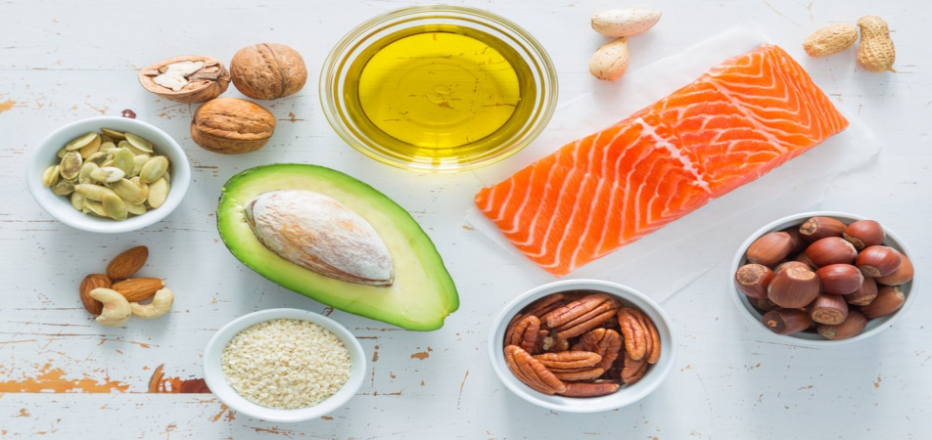
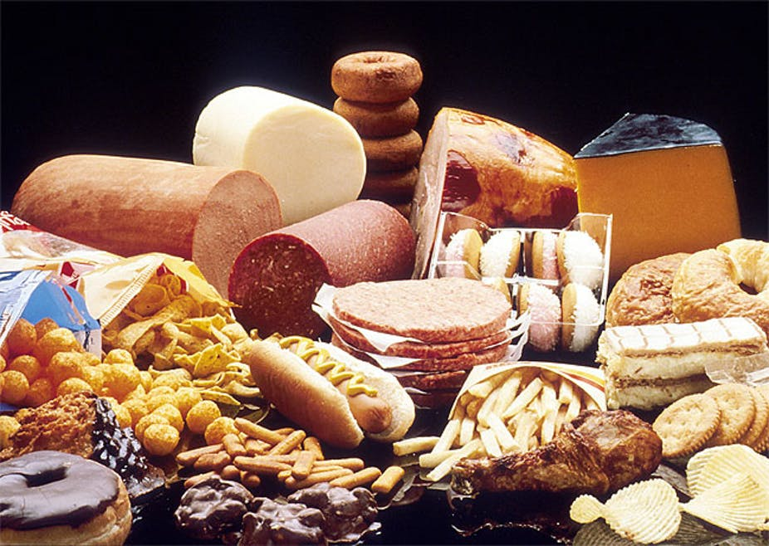
Diet and Nutrition
Good fats…
Good food helps the body and brain to work effectively, and is important for how we feel.
Try to eat:
Five portions of fruit and vegetables a day
“Good” fat and less “bad” fat
Bad fats…
Notes:
What we eat is important for how we feel. Good food also helps the body and the brain to work efficiently, so make sure you have enough of the good stuff.
Eat five portions of fruit and vegetables every day
Eat “good” fat – such as oily fish and avocado, and less of the “bad” fat such as in red meat

Slide 9
DVD Clip
Notes:
Take some time to discuss the video clip and reflect on the content

Slide 10
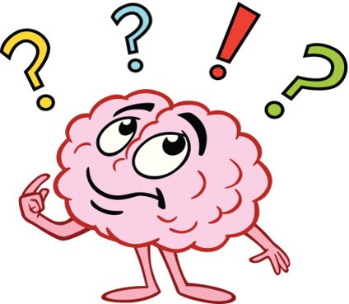
Review of Sessions
Is there anything wrong with me?
Memory aids and strategies
Finding a way through feelings
Worry, stress and memory
What is dementia?
To tell or not to tell
Living as well as you can
Staying active
How are you feeling about reaching the end of the group?
What are the most important things you have learnt from the sessions?
Is there anything you have found difficult?

Slide 11
Summary
Do you have any feedback for us?

Slide 12
Thank you for joining us for the Living Well with Dementia group!

