Slide 1
Living Well with Dementia
Session 3 –
Finding a way through feelings
Facilitated by:
Jessica Rhodes (Assistant Psychologist)
Judith Davison (Occupational Therapist)

Slide 2
Ice Breaker
Welcome back!
How has your week been?
Have you tried any new memory strategies?
Notes:
Prompting Questions:
What have you done since the last session that made you feel good
What memory aids did you use and which did you find helpful?
Do you think you would use them again?

Slide 3
Last Week
What did we discuss?
How your memory works
What helps you to remember?
Why talking about memory problems can be difficult
Notes:
Briefly recap last week’s material.

Slide 4
This Week
Finding a way through feelings
How experiencing memory problems might make us feel
The advantages and disadvantages of talking about our feelings
Notes:
Today we will continue talking about how having a memory problem can affect people. In order to understand these problems and cope with them more effectively, we first have to identify how people feel about these problems. We will then go onto talk about what you could do to relieve the not-so-pleasant emotions

Slide 5
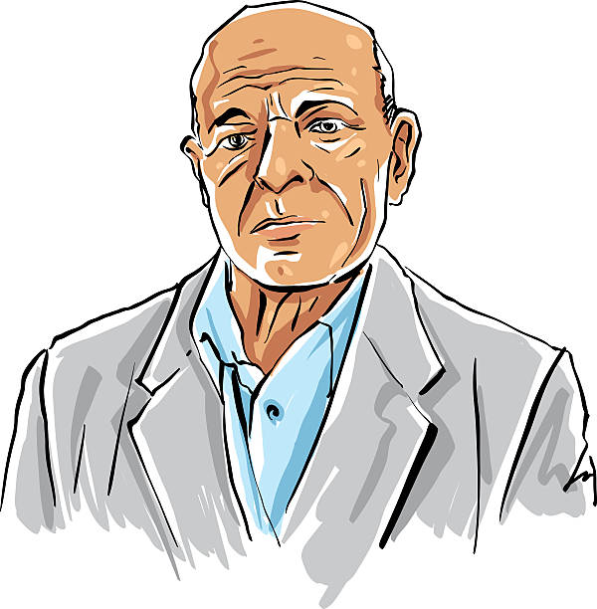
Forgetful Frank
Frank recently started losing things e.g. he often can’t find his keys when going out for a walk. At the weekend when his children came to visit, Frank couldn’t remember the name of one of his grandchildren, though the two of them used to spend a lot of time together. Frank’s wife and family have started to notice he is forgetful, but nobody has talked to him about it yet.
What hasn’t changed / things I still enjoy
Notes:
I would now like to talk about someone who has problem remembering things. Let’s call him, Frank.
How do you think Frank might feel about his memory problems?
How might he feel when he forgets his grandson’s name or loses his keys?
What do you think Frank might be worried about?
Do you think he has anyone he can talk to about his worries?
What might Frank be feeling if he goes for an assessment or receives a diagnosis?

Slide 6
Forgetful Frank
Frank recently started losing things, for example, he often can’t find his keys when going out for a walk or to a shop. At the weekend when his children came to visit, Frank couldn’t remember the name of one of his grandchildren, although the two of them used to spend a lot of time together. Frank’s wife and family have started to notice he is forgetful, but nobody has talked to him about it yet.
Have you ever felt like Frank?
What hasn’t changed / things I still enjoy

Slide 7
Working towards Acceptance
Feelings
Worry – what is the most distressing thing about having dementia?
Grief – what has changed?
Frustration – what things are more difficult now?
Anger – who are you most angry with?
Blockers
Embarrassment – feeling ‘silly’ and ‘stupid’
Guilt – about being a burden to loved ones
Going mad – worrying about going mad or that others might think this
Overwhelmed or stuck
Notes:
Blockers may cause people to avoid activities and, in turn, provoke more negative feelings e.g. if someone feels silly when they’ve forgotten something in a shop, they are more likely to avoid this situation again, and may never go shopping by themselves again

Slide 8
Is it Better to Talk about my Feelings?
Advantages
[Type as people share points]
Disadvantages
[Type as people share points]
Notes:
We have talked about Frank who’s had some difficulties with remembering important things. We have also discussed how he might feel about this, and whether he might have talked to someone about how he feels. Perhaps Frank believes that it is better not to say anything – what are the advantages and disadvantages of this?

Slide 9
DVD Clip
Notes:
Does anyone think that what the people in the DVD said is familiar?

Slide 10
Summary
What did you like about the session?
Was there anything you disliked about the session?

