Slide 1
Living Well with Dementia
Session 7 –
Living as well as you can
Facilitated by:
Jessica Rhodes (Assistant Psychologist)
Judith Davison (Occupational Therapist)
Notes:
Today we will start talking about your experiences with dementia and how you cope with any problems you might have. We will look into the problems and frustrations that you have and think about what you could do to relieve the stress.
It is normal if people feel apprehensive and worried about coming to groups, especially if the focus is a sensitive topic or illness, such as dementia. It is also normal that people feel worried about staring any new thing. The groups are friendly and we hope that you will be able to relax and feel welcome.

Slide 2
Ice Breaker
Welcome back!
How has your week been?
Have you told anyone new about your memory problems?
Notes:
Prompting Questions:
What have you done since the last session that made you feel good?
Did you talk to anyone about your dementia?
Did you talk to anyone new about it?
How did this make you feel?

Slide 3
Last Week
What did we discuss?
Have you told anyone?
Reasons to tell or not tell
Your experiences
Asking for help

Slide 4
This Week
Living as well as you can
What can I do well?
Making a change
Taking charge of your life
Driving
Notes:
Today we will talk about how you can live well with dementia. This means understanding how dementia affects you, recognising how you feel about it and how this affects what you do and don’t do. Once you know more about this, we will discuss what changes you might be able to make, and how to go about them. The aim will be to help you feel more confident about yourselves.

Slide 5
What Can I Do Well?
Name one or more thing that is going well for you…
Notes:
It is important to recognise the things that you are good at, and that are going well. Knowing what you are good at can help you feel good about yourselves and also help you feel confident. We will now look at the things that you feel good about, that are meaningful for you or that go well for you.

Slide 6
Things that aren’t Going so Well
In previous sessions we discussed…
Notes:
Remind them of the problems and frustrations discussed in the first session. Draw the group’s attention to what people had said about feelings in various situations. The aim is to help people realise that it is often the particular frustrations, problems and our ways of dealing with them, that make us feel bad, angry, embarrassed, etc. Understanding this is important for people to set up goals

Slide 7
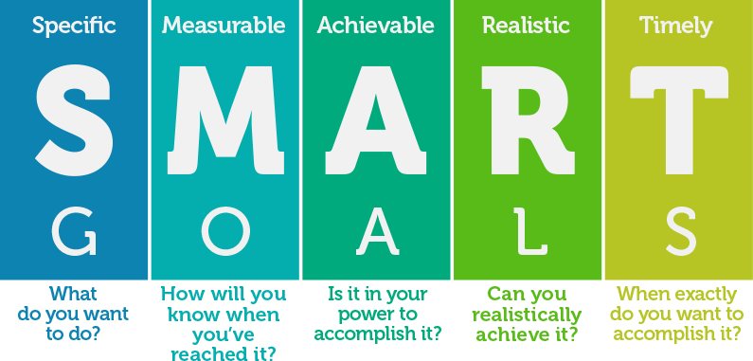
Making a Change
Notes:
Setting up goals can help people focus their attention to something they would like to change and then identify specific steps they can do to achieve it. We have talked about what makes us angry or sad, etc. and we don’t have to do the same thing again next time. Instead, we can often do something that changes the situation or changes our way of responding – we can set up goals to make such changes. But in order for the goals to really work, they need to be SMART
What does it mean?

Slide 8
Example…
Goal: Make taking walks a more pleasurable activity
Steps I can take: | I want to do this by…
Search for suitable places | Tuesday 12th
Get information about travel | Thursday 14th
Invite people to go with me | Friday 15th
Book a date in my diary | Friday 15th
Set up reminders | Friday 15th
Make preparations (e.g. food) | Friday 22nd
Go and enjoy! | Saturday 23rd
Start planning the next walk | Tuesday 26th
Notes:
The main aim of today’s session is to talk about what you could do to change your situation. We are going to separate into small groups (breakout rooms?) and each of you can set a goal – one thing that you could do to change. The goals you set should be SMART, so you can achieve them, but we will help you with that.

Slide 9
DVD Clip

Slide 10
Taking Charge of Your Life
As we age there are many different ways that we can take charge of our lives, here are some you may want to think about:
Talking to people around you about the future
Making a lasting power of attorney
Writing a will
Making a “living will” – advance decisions and advance statements
Notes:
Not everybody wants to think about these things, but some people find it helpful to feel that they have made decisions about their future. Often this is something that a person can do, and then forget about – safe in the knowledge that if things get worse, then they have made preparations Amongst the ways in which you could take charge of your life are to think about:
Talking to people around you about the future
Making a lasting power of attorney
Making a will
Making a “living will” (advance decisions and advance statements)
If you want more information about any of these ways of taking charge of your life and preparing for the future, then please ask. It is also worth noting that it these are important things to consider as we age, whether we have dementia or not.
Ask: What else can people do to take charge of their lives?

Slide 11
Driving
Who still drives?
Who has given up because of their diagnosis?
What could you do instead of driving to places?
How do you feel about these alternatives?
Notes:
Not being able to drive is one of the biggest issues that many people with dementia face. But having a diagnosis of dementia is not in itself necessarily a reason to stop driving. What matters, from both a legal and a practical point of view, is whether or not you are still able to drive safely.
However, if you have been given diagnosis of dementia and you want to continue to drive, then you must, by law, inform the DVLA.
The DVLA will ask you for your permission for them to contact your GP and/or specialists (such as the memory clinic). Based on the information they get back, they will make a decision as to whether you can continue to drive. They may also ask you to take a driving test.
You must also immediately inform your car insurance company. If you don't, then your policy may become invalid. Although giving up driving is often hard, there are many ways around the problems that not driving can create - for instance the money that you save will often more than cover the cost of getting a taxi or bus more regularly. Let’s talk about this for a while.

Slide 12
“Being told I had dementia was like a door re-opening after a difficult time in my life – new challenges, new opportunities”
James McKillop
Notes:
To finish up today’s session, I am going to read two sentences from a Scottish man who had been diagnosed with dementia – James McKillop. He wrote these ideas down a couple of years after receiving his diagnosis. James became a well-known figure in Scotland, advocating for the rights of people with dementia.

Slide 13
Summary
What did you like about the session?
Was there anything you disliked about the session?

