Slide 1

Living Well with Dementia
Session 1 –
Is there anything wrong with me?
Facilitated by:
Jessica Rhodes (Assistant Psychologist)
Judith Davison (Occupational Therapist)
Notes:
Today we will start talking about your experiences with dementia and how you cope with any problems you might have. We will look into the problems and frustrations that you have and think about what you could do to relieve the stress.
It is normal if people feel apprehensive and worried about coming to groups, especially if the focus is a sensitive topic or illness, such as dementia. It is also normal that people feel worried about staring any new thing. The groups are friendly and we hope that you will be able to relax and feel welcome.

Slide 2

Ice Breaker
Welcome to the group!
Tell everyone your name and share one fact about yourself
HELLO
My name is…
Peter

Slide 3
Your Expectations of the Group
Hopes
[Type in the box as the group share]
Fears
[Type in the box as the group share]

Slide 4
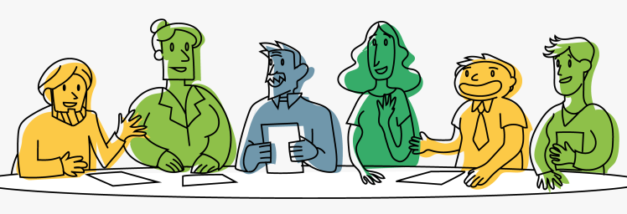
What to Expect from Group
8 sessions, once per week:
Each 1 hour 30 minutes with a tea break
The focus of the group is to help you and your family living a fulfilling life.
Notes:
In these groups we will focus on “Living Well” with dementia. What we mean by this is that we want to help you and your family to live as fulfilling a life as you can despite any difficulties that you might face.
Talking with other people who are going through similar experiences is important because that is the way in which we learn that we’re not alone. It can give us insight into our own situation and we can help each other to cope with the changes we are going through. But this is also difficult – sometimes it’s only natural to want to forget about difficult things.
In the groups we will talk at times about “recovery” but we know that there is no cure for dementia. So you cannot recover in the sense of getting better. Coming to the group won't help you to have a better memory, but we hope that you will be more able to find a way to improve your quality of life – to live better.

Slide 5
What to Expect from Group
Talking to people who are going through similar experiences is important.
Please share with the group what you feel comfortable with.
Notes:
It is normal if people feel apprehensive and worried about coming to groups, especially if the focus is a sensitive topic or illness, such as dementia. It is also normal that people feel worried about staring any new thing. The groups are friendly and we hope that you will be able to relax and feel welcome.

Slide 6
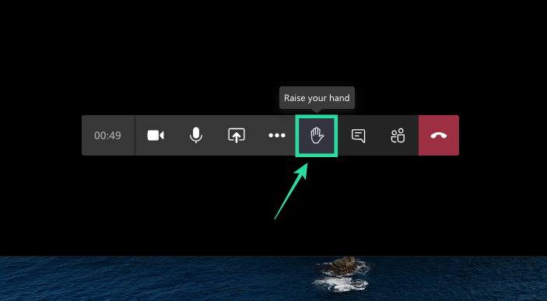

Group Rules
Make sure you are in a private space
Keep your video on at all times
Try to mute your microphone when you are not talking
Keep discussions within the group
VIDEO
MICROPHONE

Slide 7
Group Rules
[Type here as the group share ideas]
What other rules do you think will help everyone to feel safe within the group?

Slide 8
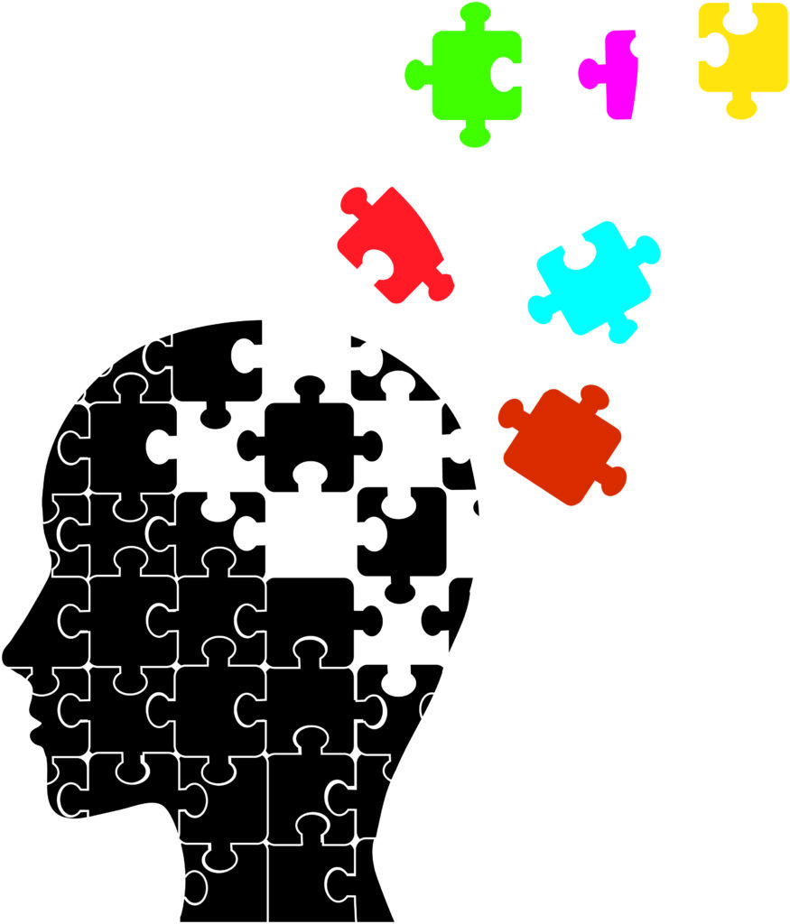
Sharing Our Experiences
Problems we have experienced
What hasn’t changed / things we still enjoy
Notes:
Talking about illnesses that we have not only helps us understand our own experience better, but also cope with the illness and find ways to live with it. Now we will start talking about how dementia affects your life.

Slide 9

Sharing Our Experiences
Problems we have experienced
What hasn’t changed / things we still enjoy

Slide 10

The Ripple Effect…
What can’t I do?
How has this made me feel?
How has this changed my life?
Notes:
Let’s summarise what people have been saying so far. Memory problems are like throwing a stone into the water – a small stone may produce ripples so that these then spread out and affect other things. This is the ripple effect – and it’s what can happen with dementia.
[Click] The sort of memory problems and other problems people have means that you can’t do things in the way that you used to be able to. It’s harder to remember what has happened, conversations you’ve had with people, to follow a programme on TV or a chapter in a book.
[Click] Because you can’t do things, so this creates difficult feelings – you may be worried, upset, embarrassed, guilty, frustrated, upset.
[Click] This then makes you do things differently. Perhaps you become cautious, and start to avoid doing things because you don’t want to get it wrong. Your memory problems may make you self-conscious, and because of that you change what you’re doing.

Slide 11
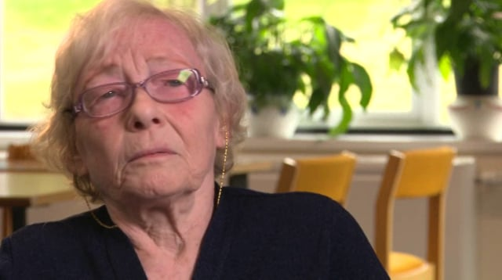
DVD Clip
Notes:
Does anyone think that what the people in the DVD said is familiar?

Slide 12

Summary
How are you feeling about your worries now?
What did you like about the session?
Was there anything you disliked about the session?
Were your initial expectations met?
Thank you for joining us – see you next time!

