Slide 1
Living Well with Dementia
Session 2 –
Memory aids and strategies
Facilitated by:
Jessica Rhodes (Assistant Psychologist)
Judith Davison (Occupational Therapist)

Slide 2
Ice Breaker
Welcome back!
If you could be any animal, what would you be and why?
Tell us about the best holiday you’ve had
Notes:
Last week we all met for the first time and started getting to know each other – let’s begin by finding out a little more about the group.
Pick one of the two questions and tell us about you!
Are there any other questions you would like to ask?

Slide 3
Last Week
What did we discuss?
Hopes and fears
What to expect from the group
Group rules
Things we can do and areas of difficulty

Slide 4
This Week
Memory aids and strategies
How your memory works
What helps you to remember?
Why talking about memory problems can be difficult
Notes:
Today we will talk about your memory and how it works. We will explore the problems you experience and the things that you can remember better. We will also look into the different ways for you to remember important things
We hope that you feel comfortable in the groups and that sharing with the group helps you understand your situation. However, if you also feel anxious or worried about anything in the group, we will try our best to help. It is completely normal to feel anxious when doing new things or when meeting more people together. If you would like to talk about it, we can do that with the group or with one of the facilitators alone during break or after session

Slide 5
How your Memory Works
Short term memory
Long term memory
Putting new information into your long-term memory so that it sticks there is a bit like putting it into a filing cabinet.
Notes:
Having explored the problems people may have with remembering things, we will now talk about how memory works.
One way to think about memory is to distinguish between our immediate and long terms memories. Our short-term memory holds the information that we see or hear for a few seconds. Long-term memory storage holds it for days, months or even years.
As we get older, and particularly if we have problems with our memory, then it often becomes harder to move information in long term storage. The information that was already often tends to stay there, but we have to make more effort to make sure we move new information out from our short term memory and into the long term memory
Dementia almost always makes it harder to move new information into long term storage, so you may not remember things as well as you used to. Today and in the first session we talked about some problems you have been experiencing.
The process of remembering is a bit like the task of a good secretary or manager. When you see or hear information you would like to memorise, you need to try and move it into the filing cabinet. But all too often it ends up not being neatly filed, and gets lost or thrown away so that you can’t find it when you need it. Putting new information into your long-term memory so that it sticks there is a bit like putting it into a file in a filing cabinet.
Does this ring any bells with you?

Slide 6
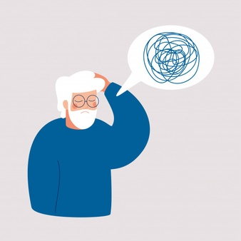
What Helps you to Remember?
[Type here as people share]
Notes:
What have you tried doing to help you remember important things?
Internal: Repeating it to yourself, making a rhyme/story, acronyms, associating
External: Diaries, calendars, post-it notes, leaving items out as a prompt
In order to remember new information it helps if we do something with it in our mind rather than just hearing or seeing it. For instance:
Organise the information in some way in your mind. For example, write it down. Even if you lose the paper, you will still have more chance of making it stick through the act of writing.
Make a link between the new information and something familiar you already know. For example, if you meet someone called Peter, you might make the link ‘Peter Pan’ if he looks young.
A letter of the alphabet can be a cue – so “P” for “Pea” if he has a round face. Once you have the first letter of a name, it acts as a trigger to help you remember it.
Repeat it to yourself – but gradually making the gaps between the repetitions longer and longer
Remembering it right the first time around will help to reduce mistakes later on.

Slide 7
DVD Clip
Notes:
Does anyone think that what the people in the DVD said is familiar?

Slide 8
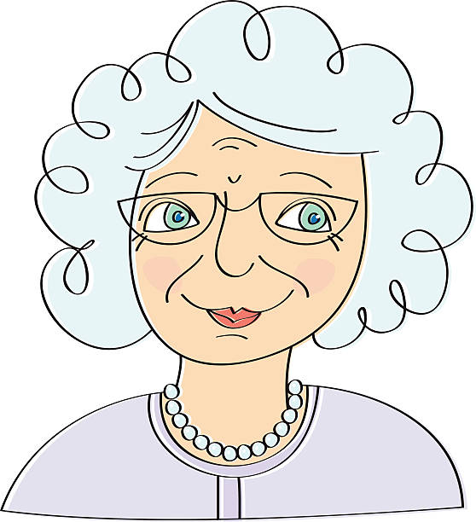
Thinking about Memory Problems
Marjory often tells people that although she is getting older, her memory is actually as sharp now as it’s ever been. The only problem is she sometimes says this three or four times in just 10 minutes and never seems to remember she has already said it.
What hasn’t changed / things I still enjoy
Notes:
I now want to talk about someone who finds it hard to think that she has any problems – let’s call her “Marjory”, although we could as easily say “Derek” or any other name. Marjory often tells people that she meets that although she is getting on, in actual fact her memory is as sharp now as it’s ever been. The only problem is that she sometimes says this three or four times in just 10 minutes and never seems to remember that she has already said it. Why do you think that might be? What do you think might make it hard for Marjory to say that there is something wrong with her memory?
Why do you think that might be?
What do you think might make it hard for Marjory to say that there is something wrong with her memory?

Slide 9
Thinking about Memory Problems
Marjory often tells people that although she is getting older, her memory is actually as sharp now as it’s ever been. The only problem is she sometimes says this three or four times in just 10 minutes and never seems to remember she has already said it.
Do you know anyone like Marjory?
What might you want to say to Marjory if you met her?
What hasn’t changed / things I still enjoy

Slide 10
Summary
What did you like about the session?
Was there anything you disliked about the session?

