Slide 1
Living Well with Dementia
Session 5 –
What is dementia?
Facilitated by:
Jessica Rhodes (Assistant Psychologist)
Judith Davison (Occupational Therapist)

Slide 2
Ice Breaker
Welcome back!
How was your week?
Let’s try another relaxation activity
Notes:
Were there any positive things you did this week?
Did you have any difficulties remembering things?
How did you cope?

Slide 3
Last Week
What did we discuss?
The effect of stress on memory
How to cope with worries
What if I can’t remember?
Relaxation activity
Notes:
Prompting Questions:
What have you done since the last session that made you feel good
What experiences of dementia may lead to different emotions?
Is there anyone that you talked to about your feelings?
Did you avoid talking about them – if so why?
How did people respond or react?

Slide 4
This Week
What is dementia?
What do you know about dementia?
The dementia journey
What is dementia?
Different types of dementia
The journey after diagnosis
Notes:
Today we will talk a little more about dementia and what different types there are. We will first discuss what you know about dementia and what you would like to know, to make sure that your questions are answered. Then, we will talk about the different types of dementia, its treatment and what you can do to help yourselves.

Slide 5
What Do you Know About Dementia?
Do you remember being diagnosed?
What do you know about dementia?
What would you like to learn about dementia?

Slide 6
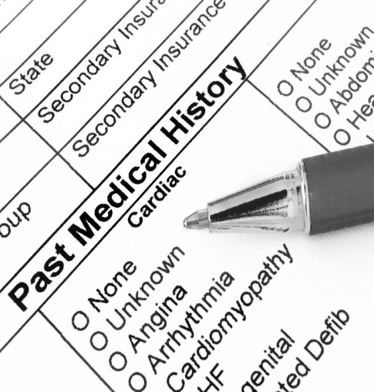
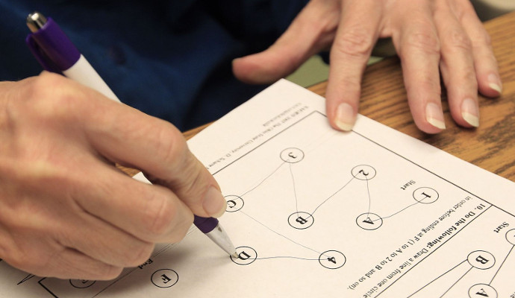
The Dementia Journey
Visit GP
Medical History
Cognitive tests
Head scan, blood and urine tests
Notes:
Sometimes people use the phrase a “dementia journey” to describe what happens to people.
For most people, the first station or stop on the dementia journey is with their GP. As many people here will know from experience, if a doctor thinks that a person might have dementia, he or she will do a number of tests to find out how a person’s memory is functioning, and whether any of their problems can be explained by another illness. The tests can also help determine which type of dementia people have:
Taking medical history: Doctors first want to know what other conditions you have, and if the memory and other problems could be explained by depression, psychosis or Parkinson’s disease.
Cognitive tests: you may have been asked questions to see how well you can remember (e.g. you may have been asked to spell “WORLD” backwards or to take 7 away from 100).
Head scan: usually doctors send the person to have a head scan – a type of x-ray of brain – in the hospital. This will likely show whether there are any visible changes in the brain.
Blood and urine tests: are usually done to screen for alternative causes of cognitive problems, for example an infection.
Where do people get their diagnosis? For some people it is just their GP that they see, but for most people the next stop on the journey is a specialist doctor in Memory clinic.
What was your experience of the process and tests?
How did you receive a diagnosis?
What happened afterwards?
How did you feel during the process?

Slide 7
What is Dementia?
DEMENTIA
Umbrella term used to describe different symptoms e.g. memory loss that interfere with daily life
Fronto-temporal
Alzheimer’s
Vascular
Lewy Body
Other types and mixed dementia
Notes:
Dementia is a word that is used to describe a group of different illnesses all of which are alike and have similar symptoms. The most common of these illnesses are Alzheimer’s disease and Vascular dementia but there are also many more. As well as differences between the different illnesses, there are also differences in how individuals experience the same types of dementia
Most people will have some or all of these symptoms:
Memory loss, particularly of recent events - This may not be severe at first but is likely to become progressively worse.
Problems finding the right words for what you want to say
Feeling disoriented. For example, not recognising familiar streets and becoming confused about the time of day.
Having trouble thinking clearly and doing practical tasks that you used to do easily
Discussion:
How do you experience your own symptoms?
Which symptoms do you have?
The two most common types of dementia are Alzheimer’s disease and Vascular dementia. We will now briefly talk about each of them

Slide 8
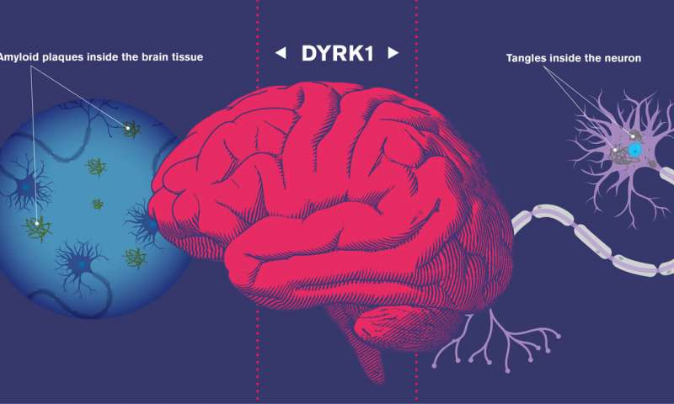
Alzheimer’s Disease
What’s the cause? We are still not sure why it happens but there are many theories. It is more common with age.
Is there treatment? There is no cure but there is medication that can help with some of the symptoms.
Does it get worse? Yes, but the speed varies for each person. For many, the progression is quite slow.
Can Alzheimer’s be passed to my children? There is an inherited form of the disease but this is rare.
Notes:
The most common type of dementia is Alzheimer’s disease. It occurs because of damage to the nerve cells in the brain. The pattern of damage can vary between individuals, so that the difficulties experienced by one person will not be exactly the same as the next.
What causes Alzheimer’s disease? Although there are many theories as to why this disease happens, we still don’t know what causes it, other than that it is more common with age.
Is it something that can be passed onto my children? There is an inherited form of the disease but this is rare. Only in a very small number of highly unusual cases which occur early in life is Alzheimer’s disease passed from one generation to the next.
Is there any treatment? There is no cure for Alzheimer's disease. However, some people are able to have some medication which can help with some of the problems of a poor memory. The most common of these is called Aricept.
Does it get worse? Yes, but the speed at which Alzheimer’s disease gets worse can vary – for many people the illness progresses quite slowly, and there is evidence now that there are things that you can do to slow it down – we will discuss this in the next few weeks.

Slide 9
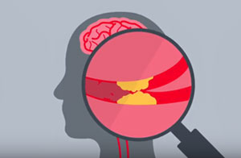
Vascular Dementia
What’s the cause? Problems with supply of blood to the brain, e.g. small strokes or bleeding within the brain.
Is there treatment? There is no cure but aspirin may be suggested to help prevent strokes from happening.
Can it be passed to my children? Genes that increase the risk can be inherited (e.g. for high blood pressure).
Does it get worse? Yes, but the speed varies for each person. There are things you can do to try slow the process.
Notes:
What is vascular dementia? This is caused by small strokes or bleeding within the brain. This is often linked with heart disease, and has the same risk factors – such as high blood pressure and high levels of cholesterol. After Alzheimer’s disease, vascular dementia is the next most common form of dementia. Moreover, many people have a mixed form of both illnesses.
Can vascular dementia be passed on? This can happen, but only in the way that risks for heart disease in general can be passed on. Recent research suggests that the factors which make vascular dementia more likely are also risks factors of Alzheimer’s disease
Is there any treatment? There are no cures for vascular dementia. Unlike Alzheimer’s disease, Aricept cannot be prescribed for people with vascular dementia. However, aspirin is often suggested, as this helps to prevent strokes from happening. There are also other things that you can do to try and reduce the speed at which he dementia will get worse:
Make sure you keep your blood pressure under control
If you smoke, then try to stop or cut down
If you drink alcohol, then make sure you drink in moderation
If you are a diabetic, then make sure you keep this under control
Make sure you take a good amount of exercise
Have a healthy diet

Slide 10
The Journey after Diagnosis
Support is available for you from various local services.
Have you accessed anything helpful so far?
Talk things through with someone
Notes:
Discuss available support within the local area and the experiences of contact with these services thus far. If people feel lacking support, it may be a good opportunity to signpost to relevant services.

Slide 11
DVD Clip

Slide 12
Summary
What did you like about the session?
Was there anything you disliked about the session?

